Slide 1
Docker & Docker Swarm
Introduction to Docker & Docker Swarm
Presented by Adi Setyono S.Si
Jakarta, 5 – 8 December 2022

Slide 2
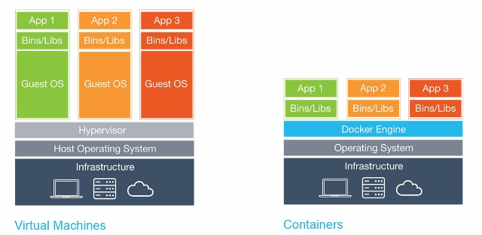
What is Docker?
Learning Docker Swarm
Docker is a set of platform as a service (PaaS) products that use OS-level virtualization to deliver software in packages called containers.

Slide 3
What is Docker Swarm?
Learning Docker Swarm
Docker Swarm provides native clustering functionality for Docker containers, which turns a group of Docker engines into a single virtual Docker engine.
Swarm Manager
Node 1
Node 2
Node 3
Bridge Network
Bridge Network
Bridge Network
Web
Web
Database
Web
Database
Web
Web
Database
Database

Slide 4
Learning Docker Swarm
Docker Swarm Cluster Networking
Swarm Manager
Overlay Network
Node 1
Node 2
Node 3
Web
Web
Database
Web
Database
Web
Web
Database
Database

Slide 5
Learning Docker Swarm
What’s Docker swarm?
A swarm is a group of machines that are running Docker and joined into a cluster.
A swarm is made up of multiple nodes, which can be either physical or virtual machines.
https://docs.docker.com/get-started/part4/#understanding-swarm-clusters

Slide 6
Learning Docker Swarm
Features of a Swarm
Cluster management integrated with Docker Engine
Decentralized design
Declarative service model
Scaling
Desired state reconciliation
Multi-host networking
Service discovery
Load balancing
Secure by default
Rolling updates
https://docs.docker.com/engine/swarm/#feature-highlights

Slide 7
Learning Docker Swarm
Docker Swarm
Swarm Manager

Slide 8
Learning Docker Swarm
Docker Swarm
Swarm Manager
Node 1
Node 2
Node 3

Slide 9
Learning Docker Swarm
Docker Swarm
Swarm Manager
Node 1
Node 2
Node 3

Slide 10
Learning Docker Swarm
Docker Swarm
Swarm Manager
Node 1
Node 2
Node 3
Container
Container
Container
Container
Container
Container
Container
Container
Container

Slide 11
Learning Docker Swarm
How is load balancing done in a Swarm?
By default traffic is routed using the ingress routing mesh and internal load balancing to handle the incoming requests. The load balancing default implementation is a round robin approach using the container DNS records e.g.
App.1 > App.2 > App.3 > App.1 > App.2 > … and so on
https://docs.docker.com/engine/swarm/ingress/

Slide 12

Implement HA with Docker Swarm
Learning Docker Swarm

Slide 13
Learning Docker Swarm
Steps for setting up Docker Swarm HA cluster
Prepare all nodes
Initialize first cluster manager
Add more manager nodes
Add worker nodes
Deploy a web interface
Deploy first stack using web interface

Slide 14
Learning Docker Swarm
Prerequisites
3 host for manager (2 vcpu, 2GB RAM, 20GB HDD)
2 host for worker (4 vcpu, 4GB RAM, 40GB HDD)
NFS for shared data storage
2 Network on each host. 1 private network for internal host communication, and 1 network for external/public communication
NOTE: for public access should only open ports on which your application will be accessed. It best not no have public access to manager nodes at all.

Slide 15
Learning Docker Swarm
Let’s get started

